Slide 1


Macroeconomics
Ninth Edition
Chapter 2
Trade-offs, Comparative Advantage, and the Market System
Copyright © 2025, 2021, 2018 Pearson Education, Inc. All Rights Reserved
Notes:
If this PowerPoint presentation contains mathematical equations, you may need to check that your computer has the following installed:
1) MathType Plugin
2) Math Player (free versions available)
3) NVDA Reader (free versions available)

Slide 2
Chapter Outline
2.1 Production Possibilities Frontiers and Opportunity Costs
2.2 Comparative Advantage and Trade
2.3 The Market System

Slide 3
Ford Faces a Trade-Off at Its Dearborn, Michigan Plant
Ford, like other auto manufacturers, is investing heavily in electric vehicles (E V s).
But devoting more resources to E V research, design, and assembly means taking resources away from other activities.
How should Ford think about this trade-off?
Notes:
Tesla ultimately sold the Model 3 in 2021 for $37,990 for the lowest priced version.

Slide 4
Scarcity and Trade-offs
Households, firms, and governments continually face decisions about how best to use their scarce resources.
Scarcity: A situation in which unlimited wants exceed the limited resources available to fulfill those wants.
Scarcity requires trade-offs. Economics teaches us tools to help make good trade-offs.
Example: When deciding how to use its scarce workers and machinery, if Ford wants to produce more F-150 Lightnings, those resources will not be available to produce other models.

Slide 5
2.1 Production Possibilities Frontiers and Opportunity Costs
Use a production possibilities frontier to analyze opportunity costs and trade-offs.
A production possibilities frontier (P P F) is a curve showing the maximum attainable combinations of two goods that can be produced with available resources and current technology.
Is the P P F a positive or normative tool?
Positive; it shows “what is,” not “what should be.”

Slide 6
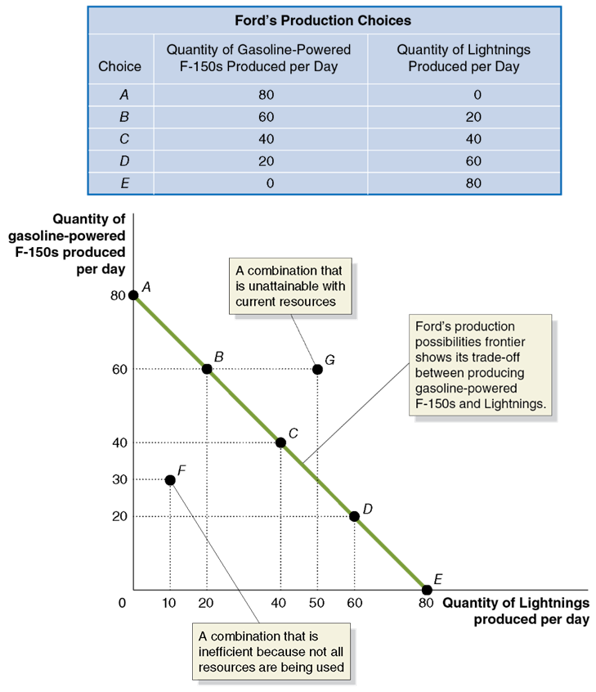
Figure 2.1 Ford’s Production Possibilities Frontier (1 of 2)
Ford can produce its gasoline-powered or electric versions of its F-150.
Producing more electric versions requires reducing the number of gasoline-powered F-150s produced.
Points on the P P F are attainable for Ford.
Points below the curve are inefficient.
Points above the curve are unattainable with current resources.
Notes:
The table is titled, Ford’s production possibilities. The column headings from left to right are choice, quantity of gasoline powered F-150s produced per day, and quantity of lightnings produced per day. The row entries are as follows. Row 1. A, 80, 0. Row 2. B, 60, 20. Row 3. C, 40, 40. Row 4. D, 20, 60. Row 5. E, 0, 80. On the graph, the X axis represents the quantity of lightnings produced per day, and the Y axis represents the quantity of gasoline powered F 150 produced per day. Data points include • A, (0, 80) • B, (20, 60) • C, (40, 40) • D, (60, 20) • E, (80, 0) • F, (10, 30) • G, (50, 60)
A downward trending line passes through points A, B, C, D, and E, and represents Ford's production possibilities frontier showing its trade off between producing gasoline powered F 150s and Lightnings. Point F represents a combination that is inefficient because not all resources are being used. Point G represents a combination that is unattainable with current resources.

Slide 7
Figure 2.1 Ford’s Production Possibilities Frontier (2 of 2)
To produce 20 more E V s (e.g., moving from point A to B), Ford must produce 20 fewer gasoline-powered F-150s.
The 20 gasoline-powered F-150s are the opportunity cost of producing 20 more F-150 Lightnings.
Opportunity cost: The highest-valued alternative that must be given up to engage in an activity.
Notes:
The table is titled, Ford’s production possibilities. The column headings from left to right are choice, quantity of gasoline powered F-150s produced per day, and quantity of lightnings produced per day. The row entries are as follows. Row 1. A, 80, 0. Row 2. B, 60, 20. Row 3. C, 40, 40. Row 4. D, 20, 60. Row 5. E, 0, 80. On the graph, the X axis represents the quantity of lightnings produced per day, and the Y axis represents the quantity of gasoline powered F 150 produced per day. Data points include • A, (0, 80) • B, (20, 60) • C, (40, 40) • D, (60, 20) • E, (80, 0) • F, (10, 30) • G, (50, 60)
A downward trending line passes through points A, B, C, D, and E, and represents Ford's production possibilities frontier showing its trade off between producing gasoline powered F 150s and Lightnings. Point F represents a combination that is inefficient because not all resources are being used. Point G represents a combination that is unattainable with current resources.

Slide 8
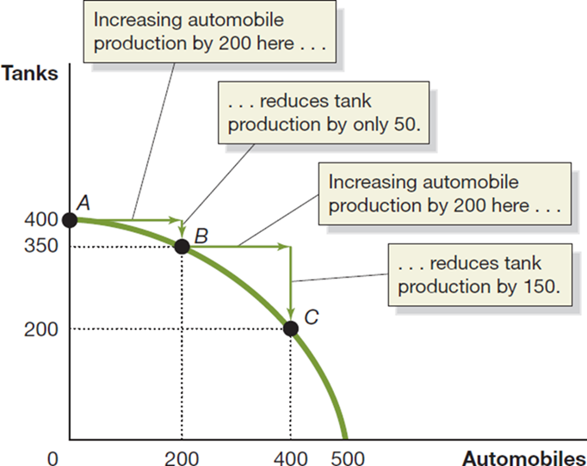
Figure 2.2 Increasing Marginal Opportunity Costs
On the previous slide, opportunity costs were constant.
But opportunity costs are often increasing.
Why? Some resources are better suited to one task than another. The first resources to “switch” are the one best suited to switching.
The more resources already devoted to an activity, the smaller the payoff to devoting additional resources to that activity.
Notes:
The X-axis represents automobiles, and the Y-axis represents tanks. The data set includes A, (0, 400), B, (200, 350), and C, (400, 200). A curved line falls through the points. The base between points A and B is increasing automobile production by 200, and the height reduces tank production by on 50. The base between points B and C is increasing automobile production by 200, and this reduces tank production by 150.

Slide 9
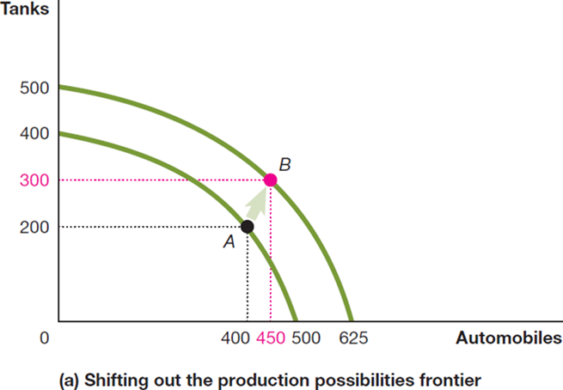
Figure 2.3 Economic Growth (Panel (a))
As more economic resources become available, the economy can move from point A to point B, producing more tanks and more automobiles.
Shifts in the production possibilities frontier represent economic growth.
Economic growth: The ability of the economy to increase the production of goods and services.
Notes:
Panel (a) shows that as more economic resources become available and technological change occurs, the economy can move from point A to point B, producing more tanks and more automobiles.
Panel (a) represents shifting out the production possibilities frontier. The X-axis represents automobiles, and the Y-axis represents tanks. A shift occurs between points A, (400, 200), and B, (450, 300), notated with an arrow. A curve passes through each of the points.

Slide 10
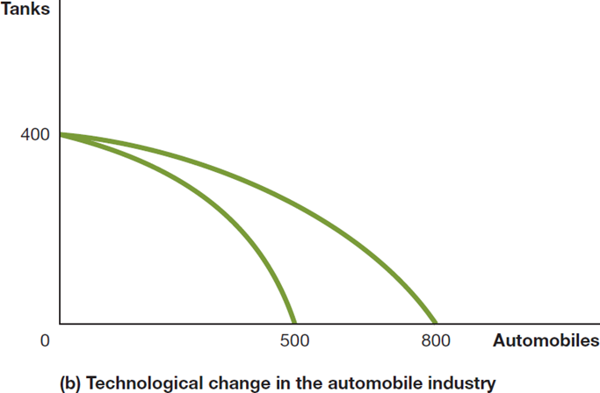
Figure 2.3 Economic Growth (Panel (b))
This panel shows technological improvement in the automobile industry.
The quantity of tanks that can be produced remains unchanged.
As in the previous slide, many previously unattainable combinations are now attainable.
Notes:
Graph B represents technological change in the automobile industry. The X axis represents automobiles, and the Y axis represents tanks. Two curves are plotted that start at (0, 400), diverge and end at (500, 0) and (800, 0), respectively.

Slide 11
Extra Apply the Concept: A P P F for Exam Grades
Suppose you have a limited amount of time to study for two exams, Economics and Accounting.
What would the production possibilities curve for the exam grades look like?
A straight line, like the P P F for Tesla’s vehicles, or
A bowed-outward curve, like the P P F for tanks and automobiles?
Answer: 2, the first hour spent studying economics is much more valuable (and has a lower opportunity cost) than the last hour.

Slide 12
2.2 Comparative Advantage and Trade
Describe comparative advantage and explain how it serves as the basis for trade.
You and your neighbor each have a limited time to pick apples and/or cherries.
The table shows the amount of each fruit that you could each pick, by devoting all of your time to that fruit.
Blank | You Apples | You Cherries | Your Neighbor Apples | Your Neighbor Cherries
Devote all time to picking apples | 20 pounds | 0 pounds | 30 pounds | 0 pounds
Devote all time to picking cherries | 0 pounds | 20 pounds | 0 pounds | 60 pounds

Slide 13
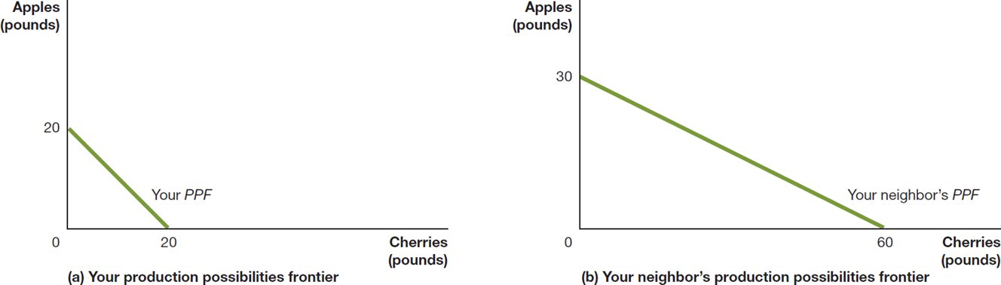
Figure 2.4 Production Possibilities for You and Your Neighbor, Without Trade (1 of 2)
If you spend all of your time picking cherries, you can pick 20 pounds of cherries; or if you spend all your time picking apples, you can pick 20 pounds of apples.
Your neighbor can similarly pick 60 pounds of cherries or 30 pounds of apples.
Notes:
Panel (a) shows your production possibilities frontier. Cherries, in pounds, is on the x-axis, and apples, in pounds, is on the y-axis. A line starts at (0, 20) and falls diagonally to the right to (20, 0). This is Your PPF
Panel (b) shows your neighbor's production possibilities frontier. The axes are the same. A line starts at (0, 30) and falls diagonally to the right to (60, 0). This is your neighbor's PPF.

Slide 14
Specialization and Gains from Trade
What if you and your neighbor decided to specialize and trade?
Trade: The act of buying and selling.
Could your neighbor benefit from trade? She is better at picking both apples and cherries…
Both of you can benefit from trade by specializing in what you are relatively good at. Let’s see how…

Slide 15
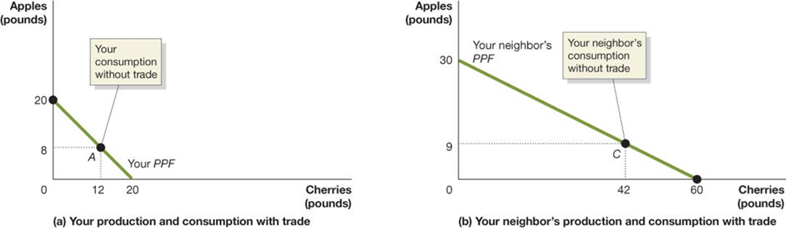
Figure 2.4 Production Possibilities for You and Your Neighbor, Without Trade (2 of 2)
When you don’t trade with your neighbor, let’s say you pick and consume 8 pounds of apples and 12 pounds of cherries per week—point A in panel (a).
When your neighbor doesn’t trade with you, she picks and consumes 9 pounds of apples and 42 pounds of cherries per week—point C in panel (b).
Notes:
The graphs are as follows. (a) Your production and consumption with trade. The X axis represents cherries in pounds, and the Y axis represents the apples in pounds. The graph plots a line representing your P P F starts at (0, 20), passes through point A (12, 8), and ends at (20, 0). The point A (12, 8) is your consumption without trade. (b) The X axis represents cherries in pounds, and Y represents apples in pounds. The graph plots a line that represents your neighbor’s P P F. The line starts at (0, 30), passes through C (42, 9), and ends at (60, 0). Point C, (42, 9) is your neighbor’s consumption without trade.

Slide 16
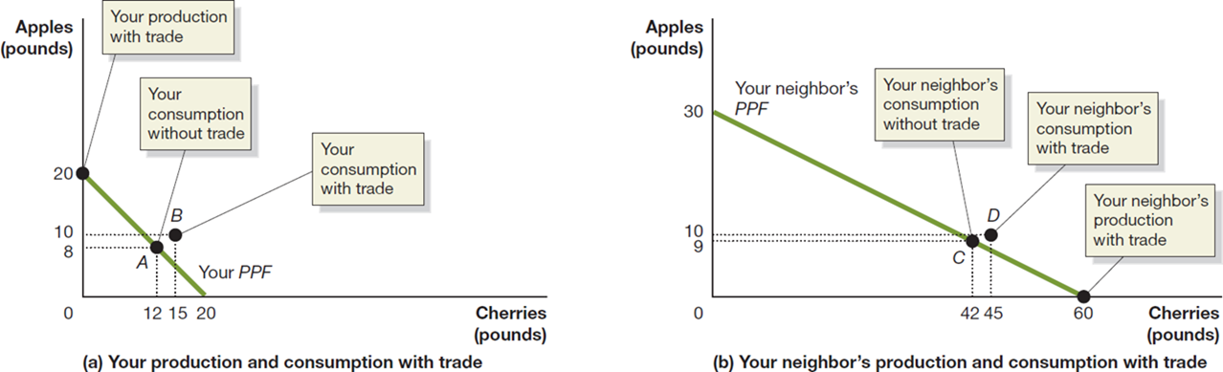
Figure 2.5 Gains From Trade (1 of 2)
If you specialize in picking apples, you can pick 20 pounds. If your neighbor specializes in picking cherries, she can pick 60 pounds.
If you trade 10 pounds of your apples for 15 pounds of your neighbor’s cherries, you will be able to consume 10 pounds of apples and 15 pounds of cherries— point B in panel (a).
Notes:
Panel (a) shows your production and consumption with trade. Cherries is plotted versus apples, with both shown in pounds. The line your PPF starts at (0, 20), which is your production with trade, and falls diagonally to (20, 0). The line passes through point A, at (12, 8), which is your consumption without trade. Point B, at (15, 10), is your consumption with trade. Part (b) shows your neighbor's production and consumption with trade. The axes are the same. A line starts at (0, 30) and falls diagonally to the right to (60, 0), which is your neighbor's production with trade. The line is your neighbor's PPF. The line passes through point C, at (42, 9), which is your neighbor’s consumption without trade.

Slide 17
Figure 2.5 Gains From Trade (2 of 2)
Your neighbor can now consume 10 pounds of apples and 45 pounds of cherries—point D in panel (b). You and your neighbor are both better off as a result of trade.
Note that your neighbor benefits from trade even though she could produce more of either fruit than you could.
Notes:
In Panel (a), the X-axis represents cherries in pounds, and Y represents apples in pounds. The point at (0, 20) is your production trade. Point A, (12, 8) is your consumption without trade. Point B, (15, 10), is your consumption with trade. The line that runs through the points is the production possibilities frontier.
In Panel (b), the X-axis represents cherries in pounds, and Y represents apples in pounds. Point C, (42, 9), is your neighbor’s consumption without trade. Point D, (45, 10), is your neighbor’s consumption with trade. Point (60, 0) is your neighbor’s production with trade. The line running through the points is your neighbor’s production possibilities frontier.

Slide 18
Table 2.1 A Summary of the Gains from Trade
Blank | You Apples (in pounds) | You Cherries (in pounds) | Your Neighbor Apples (in pounds) | Your Neighbor Cherries (in pounds)
Production and consumption without trade | 8 | 12 | 9 | 42
Production with trade | 20 | 0 | 0 | 60
Consumption with trade | 10 | 15 | 10 | 45
Gains from trade (increased consumption) | 2 | 3 | 1 | 3
Both you and your neighbor are able to consume more with trade than without.

Slide 19
Explaining the Gains From Specialization and Trade
How could both of you benefit from trade when your neighbor was so much better than you?
Economists say your neighbor had an absolute advantage in both cherry and apple picking, but you had a comparative advantage in picking apples.
Absolute advantage: The ability of an individual, a firm, or a country to produce more of a good or service than competitors, using the same amount of resources.
Comparative advantage: The ability of an individual, a firm, or a country to produce a good or service at a lower opportunity cost than competitors.

Slide 20
Table 2.2 Opportunity Costs of Picking Apples and Cherries
Blank | Opportunity Cost of Picking 1 Pound of Apples | Opportunity Cost of Picking 1 Pound of Cherries
You | 1 pound of cherries | 1 pound of apples
Your Neighbor | 2 pounds of cherries | 0.5 pound of apples
The basis for trade is comparative advantage, not absolute advantage.
Individuals, firms, and countries are better off if they specialize in producing goods and services for which they have a comparative advantage and obtain the other goods and services they need by trading.

Slide 21
Apply the Concept: Comparative Advantage, Opportunity Cost, and Housework
People living together have to divide up household chores.
Basic economic concepts like comparative advantage can provide useful insight in the division of labor.
Suppose Jack is faster than Jill at both cooking and laundry. However:
Jack is much faster at preparing tasty meals, while
Jack is only a little faster at doing laundry
Jack’s comparative advantage is in cooking—to cook a tasty meal, he gives up the opportunity to do less laundry than Jill—so he should specialize in this, while Jill specializes in laundry.

Slide 22
2.3 The Market System
Explain the basics of how a market system works.
A market is a group of buyers and sellers of a good or service, and the institution or arrangement by which they come together to trade.
Two key groups participate in the modern economy:
Households consist of individuals who provide the factors of production: labor, capital, natural resources, and other inputs used to make goods and services.
Firms purchase these factors of production from households and use them to create goods and services.

Slide 23
The Four Factors of Production
Labor: All types of work, from the part-time labor of teenagers working at McDonald’s to the work of senior managers in large corporations.
Capital: Refers to physical capital, such as computers, office buildings, and machine tools, used to produce other goods.
Natural resources: Land, water, oil, iron ore, and other raw materials (or “gifts of nature”) that are used in producing goods.
An entrepreneur is someone who operates a business. Entrepreneurial ability is the ability to bring together the other factors of production to successfully produce and sell goods and services.

Slide 24
Households and Firms
Blank | Households | Firms
What they sell: | Sell factors of production to firms in factor markets | Sell goods and services to households in product markets
What they buy: | Buy goods and services from firms in product markets | Buy factors of production from households in factor markets
Factor market: A market for the factors of production, such as labor, capital, natural resources, and entrepreneurial ability.
Product market: A market for goods—such as computers—or services—such as medical treatment.

Slide 25

Figure 2.6 The Circular-Flow Diagram (1 of 2)
Circular-flow diagram: A model that illustrates how participants in markets are linked.
Households provide factors of production to firms.
Firms provide goods and services to households.
Firms pay money to households for the factors of production.
Households pay money to firms for the goods and services.
Notes:
Households influence factor markets by providing labor, capital, natural resources and entrepreneurial ability to firms. Firms influence product markets that provide goods and services to the households. Households consume from the product markets. This consumption of goods and services helps firms earn profits. Firms use that profit to fund research from the factor markets that are passed on as wages and other payments to households.

Slide 26
Figure 2.6 The Circular-Flow Diagram (2 of 2)
Like all economic models, the circular-flow diagram is a simplified version of reality:
No government
No financial system
No foreign buyers and sellers of goods
We will explore these sectors in later chapters.
Notes:
Households influence factor markets by providing labor, capital, natural resources and entrepreneurial ability to firms. Firms influence product markets that provide goods and services to the households. Households consume from the product markets. This consumption of goods and services helps firms earn profits. Firms use that profit to fund research from the factor markets that are passed on as wages and other payments to households.

Slide 27
The Gains From Free Markets
A free market is one with few government restrictions on how a good or service can be produced or sold or on how a factor of production can be employed.
Countries that come closest to the free market benchmark have been more successful than those with centrally planned economies in providing their people with rising living standards.
This concept is not new: Adam Smith argued for free markets in his 1776 treatise, An Inquiry into the Nature and Causes of the Wealth of Nations.

Slide 28
The Market Mechanism
It is not immediately obvious that markets will do better than centrally planned systems for satisfying human desires.
After all, individuals are acting only in their own rational self-interest.
But markets with flexible prices allow the collective actions of households and firms to signal the relative worth of goods and services.
In this way, the “invisible hand” of the market allows individual responses to collectively end up satisfying the wants of consumers.

Slide 29
How does the Market Mechanism Work?
Suppose many consumers switch from buying gasoline-powered cars to buying electric cars.
Firms will find they can charge more for electric cars.
The self-interest of these firms will lead them to produce more electric cars, since these are now more profitable.
We don’t need anyone (such as a government) to be in charge of this decision-making; it will happen organically.
However we need flexible prices in order for the correct price signals to reach firms.

Slide 30
How the Market Mobilizes Knowledge
To function well, the economy must process enormous amounts of knowledge or information.
Some knowledge is general and widely-available. But some are known only locally, perhaps only by a few people.
These individuals use their knowledge for their own benefit—increased profit etc.—but this helps price signals to be sent throughout the economy.
This local knowledge is critical for adapting to changing conditions, something that happens much faster in market systems than in centrally-planned economies.

Slide 31

Apply the Concept: How Do You Make an i Pad?
How do you make an i Pad?
Although Apple engineers designed the i Pad, Apple does not manufacture i Pad components, nor does it assemble the final product.
Hundreds of firms are involved; many probably don’t even know their products will be used in an i Pad.
But guided by their own self-interest, they all contribute to the final product—without any desire to enrich Apple or provide enjoyment for i Pad purchasers.

Slide 32
The Role of the Entrepreneur in the Market System
An entrepreneur is someone who operates a business, bringing together the factors of production—labor, capital, and natural resources—to produce goods and services.
The best entrepreneurs create products that consumers never even knew they wanted.
“If I had asked my customers what they wanted, they would have said a faster horse.”
- Henry Ford
Entrepreneurs make a vital contribution to economic growth, often with considerable personal risk and sacrifice.

Slide 33
The Legal Basis of a Successful Market System
In a free market, the government does not restrict how firms produce and sell goods or how they employ factors of production.
However, governments must provide a sound legal environment that will allow the market system to succeed, including:
Protection of private property
When criminals can take your wages or profits, households and firms have little incentive to work hard.
Property rights: The rights individuals or firms have to the exclusive use of their property, including the right to buy or sell it.
Enforcement of contracts and property rights
Important for transactions across time to occur.
An independent court system is critical for this.

Slide 34

Apply the Concept: What Is Socialism? (1 of 2)
In his book Das Kapital, Karl Marx argued that the market system (capitalism) would be replaced by a communist economy controlled by workers.
Countries adopting communism have instead become centrally planned, with firm government control.
After
a new trend
emerged: social democratic parties.

Slide 35
Apply the Concept: What Is Socialism? (2 of 2)
Social democratic parties favor a large role for government in the economy, sometimes including government ownership or control of some large industries.
This is not socialism in the Marxist tradition; but its proponents argue for an increased role for government in sectors like health care and education.

Slide 36

Copyright
This work is protected by United States copyright laws and is provided solely for the use of instructors in teaching their courses and assessing student learning. Dissemination or sale of any part of this work (including on the World Wide Web) will destroy the integrity of the work and is not permitted. The work and materials from it should never be made available to students except by instructors using the accompanying text in their classes. All recipients of this work are expected to abide by these restrictions and to honor the intended pedagogical purposes and the needs of other instructors who rely on these materials.

